Slide 1
GPU Architecture & Programming

Slide 2
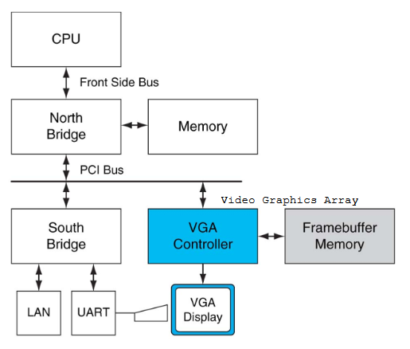
System with simple CPU and Video Cards

Slide 3
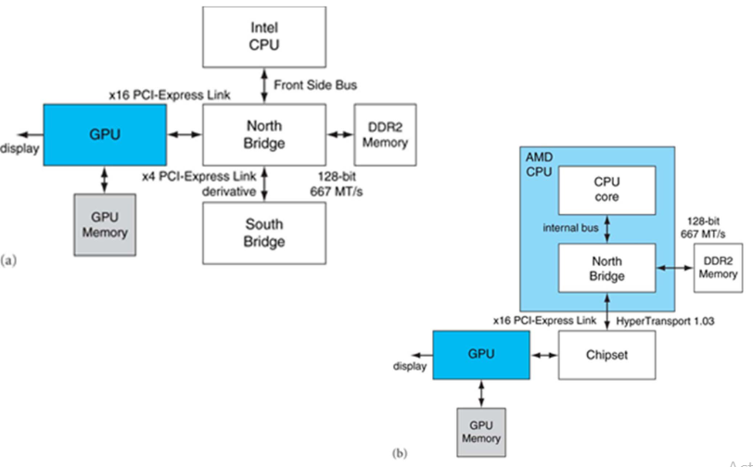
System with GPU

Slide 4
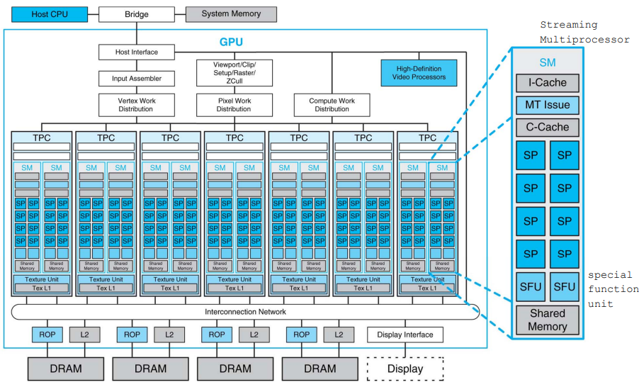

Slide 5
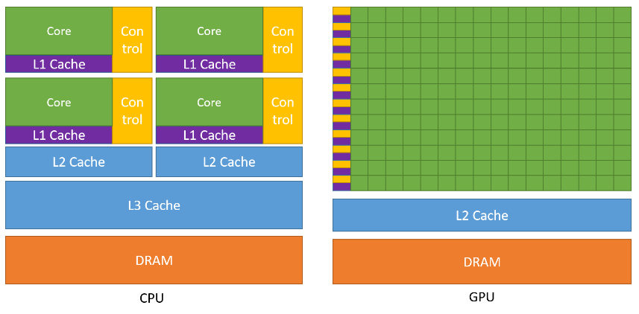
Multicore CPU vs GPU

Slide 6
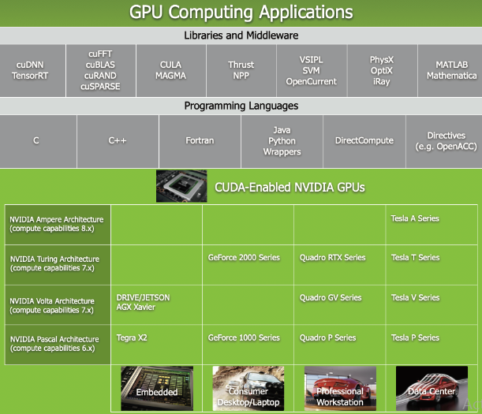

Slide 7
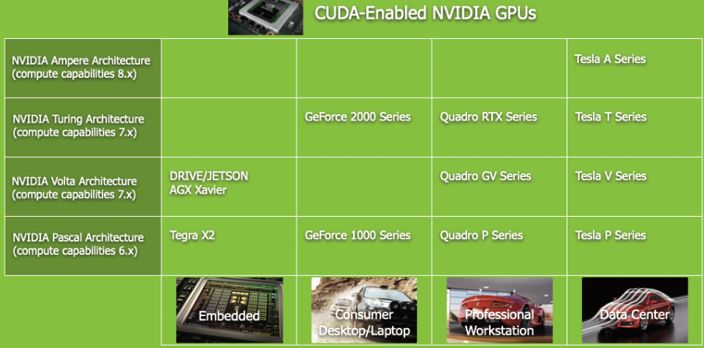

Slide 8
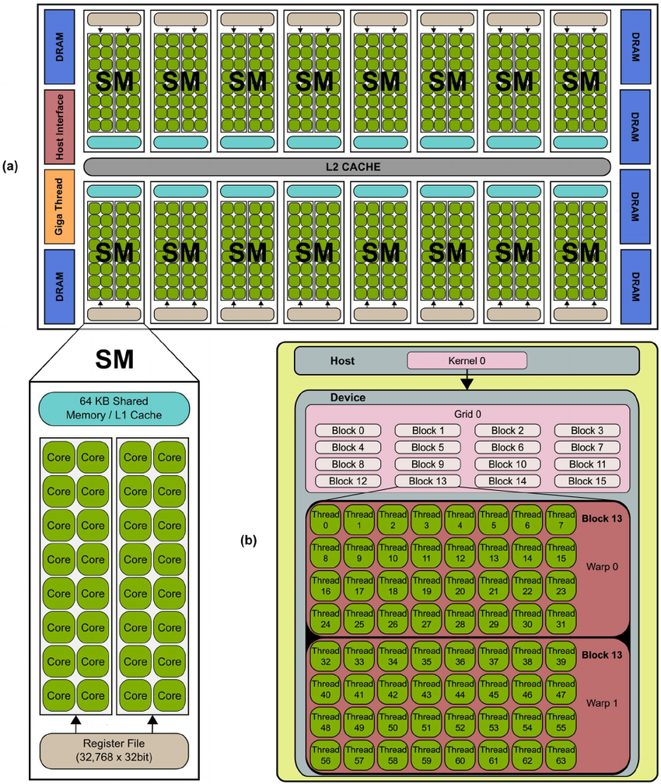

Slide 10
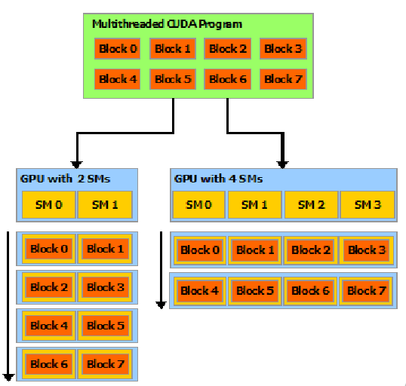
CUDA Applications on GPU

Slide 11
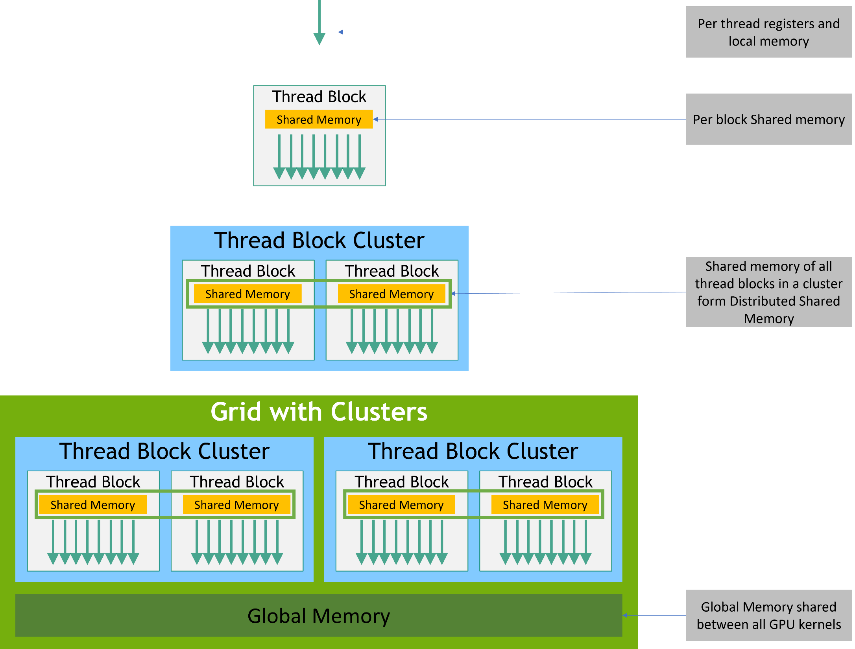

Slide 12
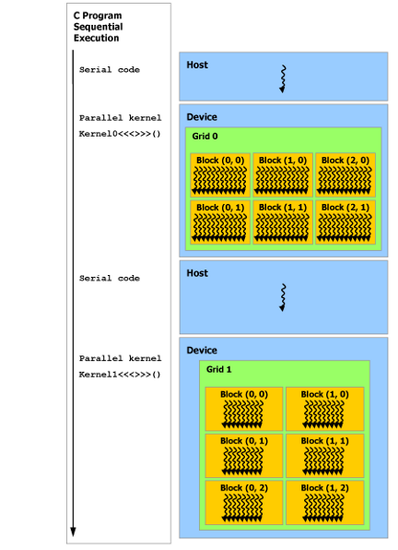

Slide 13
Example 1 : Hello World from GPU (1x10)
$ ./hello Hello World from CPU! Hello World from GPU! Hello World from GPU! Hello World from GPU! Hello World from GPU! Hello World from GPU! Hello World from GPU! Hello World from GPU! Hello World from GPU! Hello World from GPU! Hello World from GPU!
#include <stdio.h>
__global__ void helloFromGPU (void)
{
printf(“Hello World from GPU!\n”);
}
int main(void)
{
// hello from cpu
printf(“Hello World from CPU!\n”);
helloFromGPU <<<1, 10>>>();
cudaDeviceReset();
return 0;
}

Slide 14
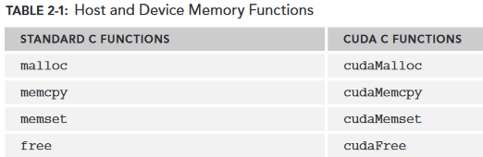
Memory Management Functions

Slide 15
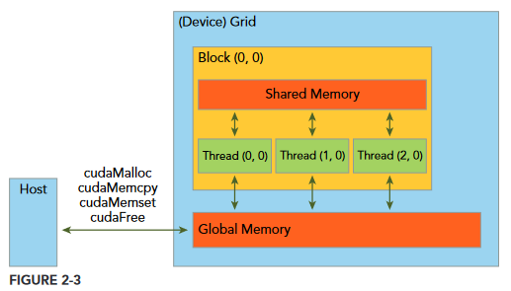
Data Transfer between CPU and GPU

Slide 16
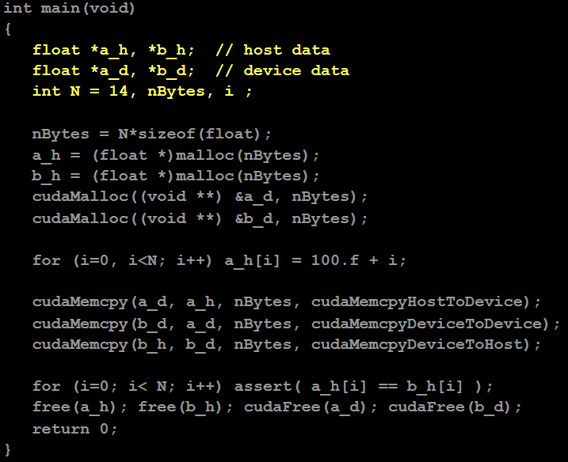
Example 2 : Data Transfer CPU GPU

Slide 17
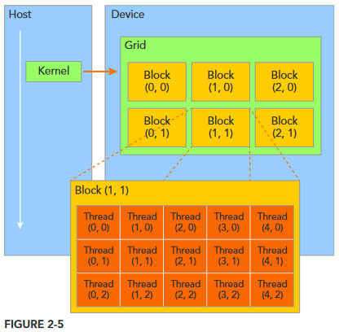
CUDA Threads (SIMT)
Thread Hierarchy
Threads launched for a parallel section are partitioned into thread blocks
Grid = all blocks for a given launch
Thread block is a group of threads that can:
Synchronize their execution
Communicate via shared memory

Slide 18
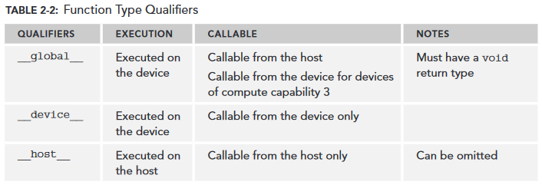
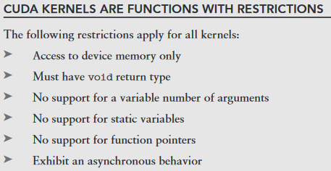

Slide 19
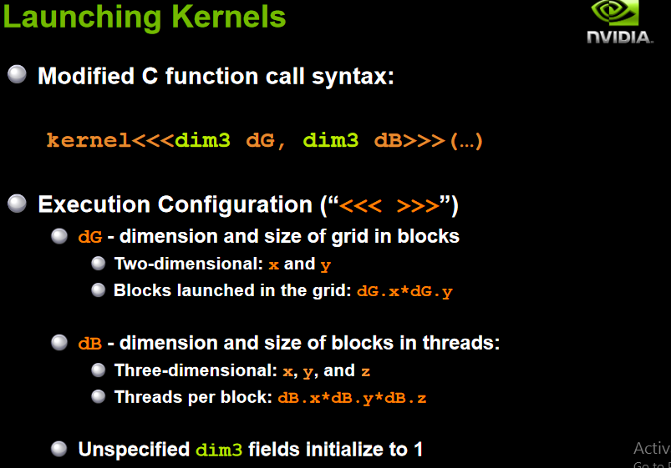

Slide 20
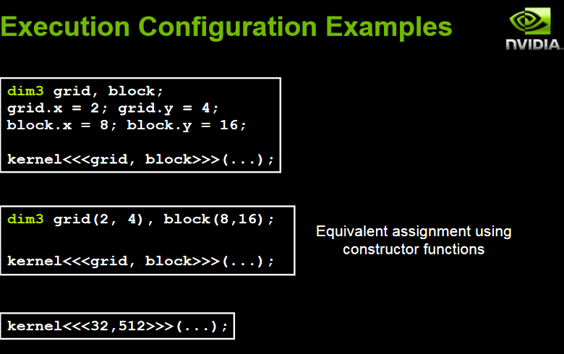

Slide 21
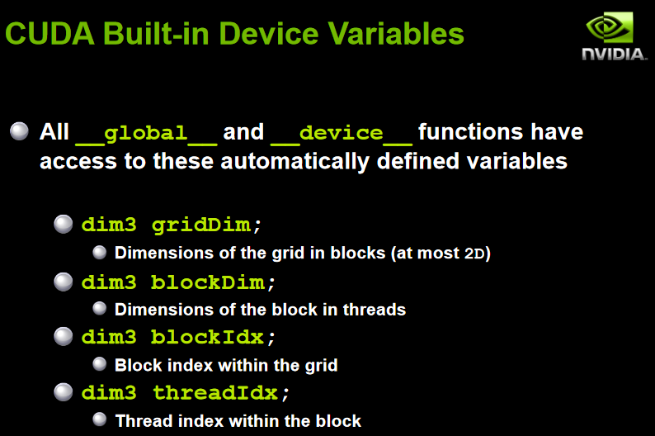

Slide 22
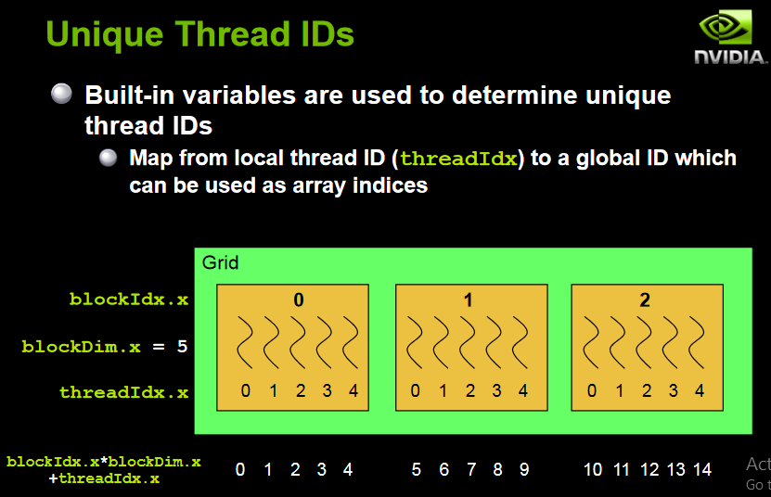

Slide 23
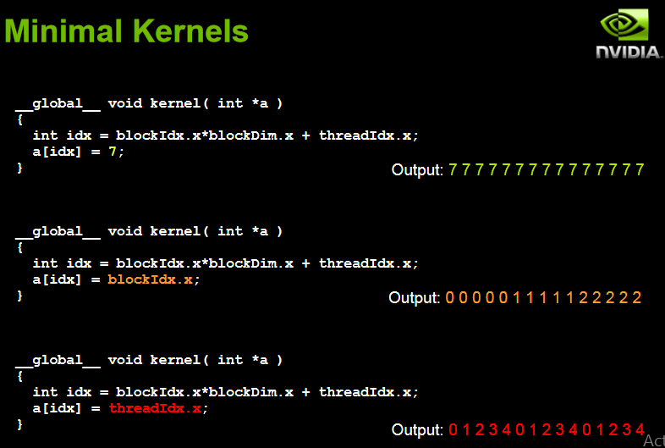

Slide 24
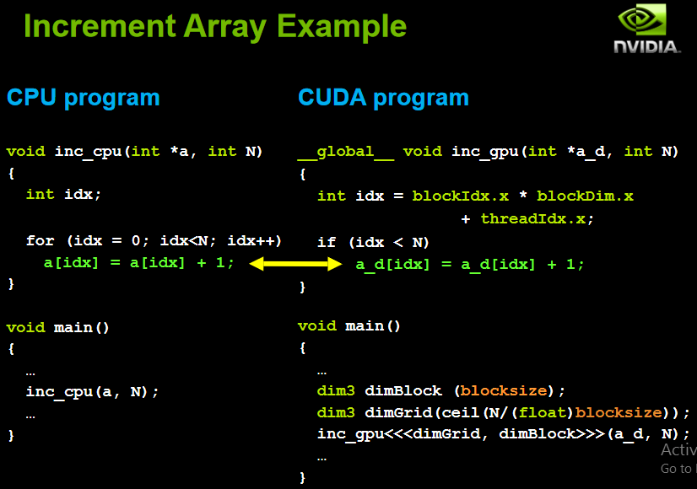

Slide 25
CUDA C Examples
Vector Addition
https://github.com/olcf-tutorials/vector_addition_cuda
Finding Maximum Value in an array
https://www.geeksforgeeks.org/how-to-run-cuda-c-c-on-jupyter-notebook-in-google-colaboratory/
Matrix Addition
https://github.com/jcbacong/CUDA-matrix-addition
Matrix Multiplication
https://github.com/lzhengchun/matrix-cuda

Slide 26
GPU Compute Capability and Limits
Technical Specifications per Compute Capability from 5.0 to 9.0
https://developer.nvidia.com/cuda-gpus
https://docs.nvidia.com/cuda/cuda-c-programming-guide/index.html#features-and-technical-specifications
Maximum dimensionality of grid of thread blocks | 3
Maximum x -dimension of a grid of thread blocks | 2³¹-1
Maximum y- or z-dimension of a grid of thread blocks | 65535
Maximum dimensionality of thread block | 3
Maximum x- or y-dimensionality of a block | 1024
Maximum z-dimension of a block | 64
Maximum number of threads per block | 1024

Slide 27
Reference
Book : CUDA C/C++ Programming Guide
https://docs.nvidia.com/cuda/cuda-c-programming-guide
Book : PROFESSIONAL CUDA® C Programming – 2014
https://www.cs.utexas.edu/~rossbach/cs380p/papers/cuda-programming.pdf
Tutorials (CMU &
https://people.cs.pitt.edu/~melhem/courses/xx45p/cuda1.pdf
https://www.cs.cmu.edu/afs/cs/academic/class/15418-s18/www/lectures/06_gpuarch.pdf
Workshop (Cornell)
https://cvw.cac.cornell.edu/GPUarch/default

